Slide 1
Office 365 Development
July 2014

Slide 2
O3657-1 Deep dive into building standalone AngularJS web applications with Bootstrap for Office 365
Speaker
Speaker

Slide 3

Agenda
Working with Bootstrap
Introduction to AngularJS
Modules, Directive and Data Binding
Routes, Views and Controllers
Creating Custom Services in Angular Apps

Slide 4
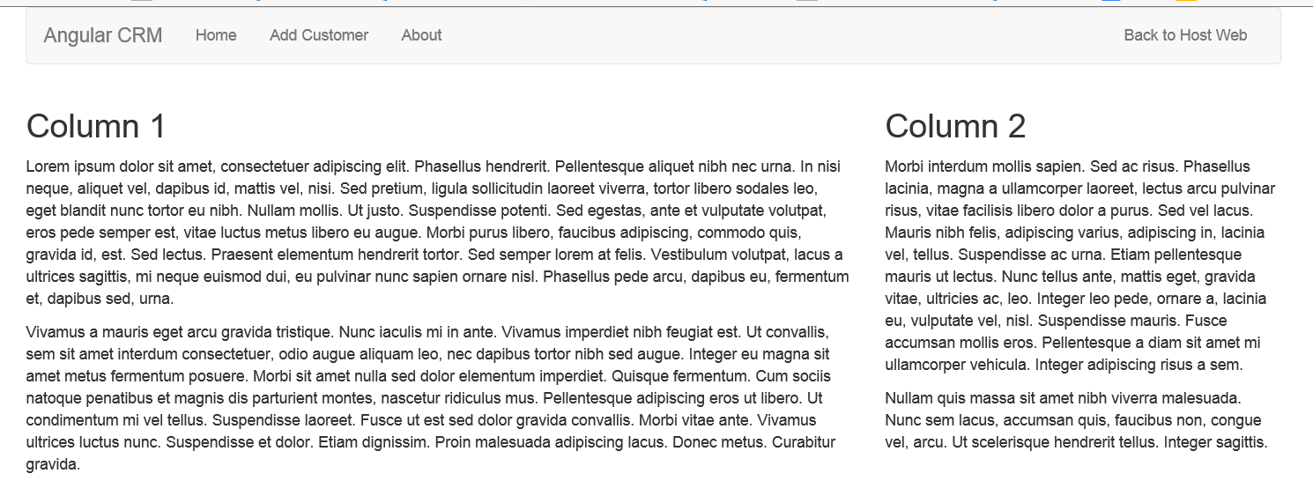
What is Bootstrap?
A CSS-based Framework for faster web development
Predefined classes for page layout with navbars, columns, forms, tables, etc.
Provides much faster way to create HTML-based user interfaces
Very good for creating mobile-friendly layouts

Slide 5
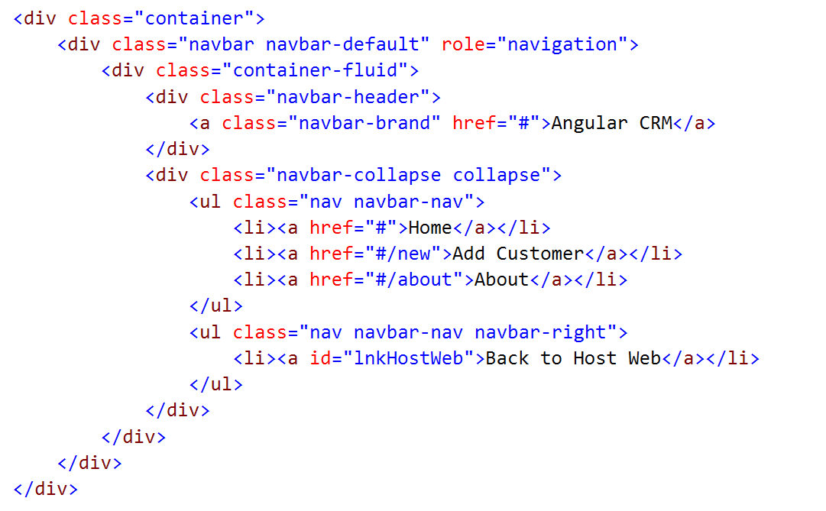
Creating a Navbar using Bootstrap

Slide 6
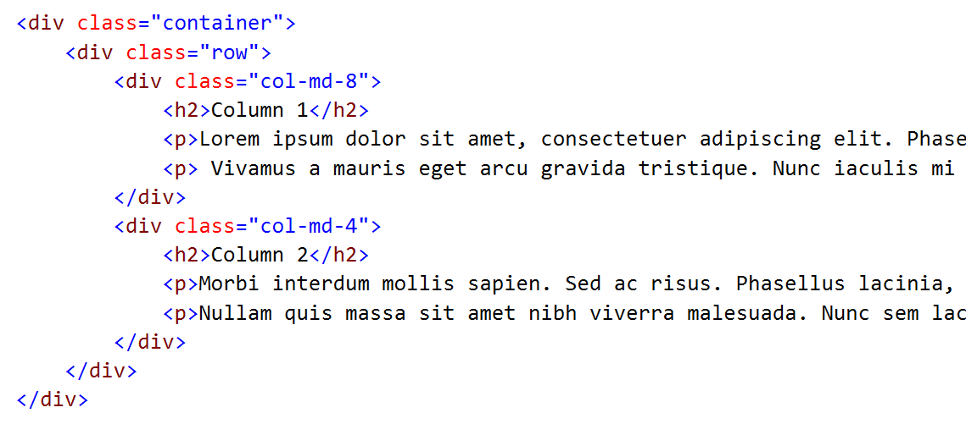
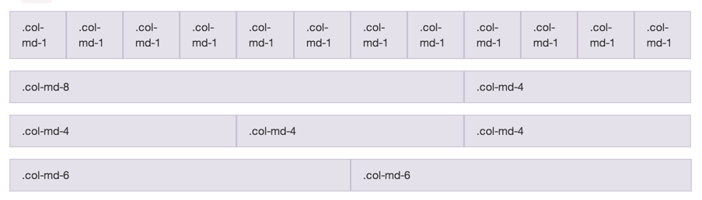
Grid Layout

Slide 7
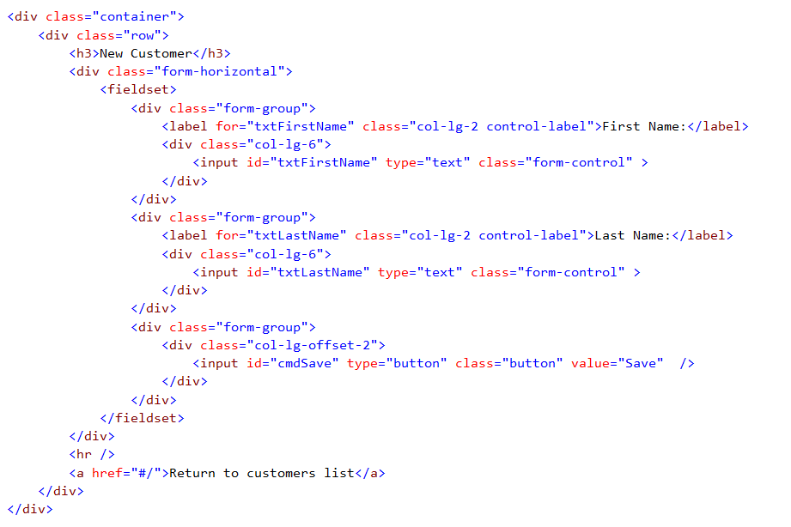
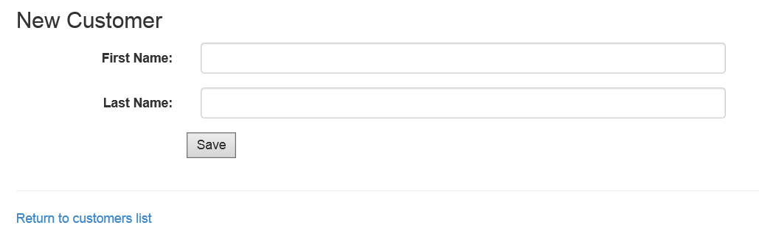
Bootstrap Forms

Slide 8
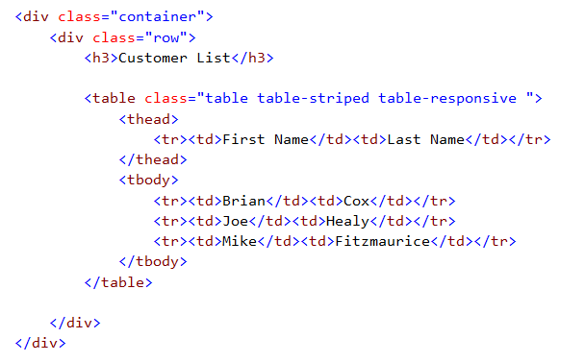
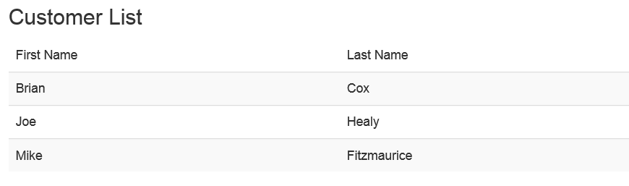
Bootstrap Table Classes

Slide 9
demo
Creating a User Interface using Bootstrap

Slide 10
Introduction to AngularJS

Slide 11

Introducing AngularJS
Description
Single-Page Application (SPA) Framework
Implements Model-View-Controller (MVC) Pattern
Why Angular
True framework instead of patchwork of libraries
Strong separation of concerns

Slide 12
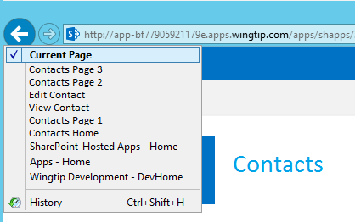
Single-Page Applications
App has one page
Different views are loaded dynamically
Routes are used to simulate pages
History list reflects route navigation
Id
First Name
Last Name
Id
1
First Name
Scot
Contacts.html
Last Name
Hillier

Slide 13
Angular JS Features
Modules
A container for functionality like controllers
Directives
Shared declarative functionality
Data Binding
Declarative binding to HTML elements
Controllers and Views
Maps URIs to dynamic views
Custom Services
Shared programmatic functionality

Slide 14
Angular Framework
Module
Routes
View
$scope
Controller
Directives
Factory

Slide 15
Other Options for Accessing Angular JS
Official Site
http://angularjs.org/
CDN
https://ajax.googleapis.com/ajax/libs/angularjs/1.0.1/angular.min.js

Slide 16
demo
Using AngularJS in a Sharepoint-hosted App Project

Slide 17
Modules, Directive and Data Binding

Slide 18
Directives
Utilizes HTML5 custom data attributes
Spec allows for the addition of custom attributes starting with data-
Angular uses directives for declarative programming
Angular directives start with “ng-”
data-ng-app, initializes the app
data-ng-controller, invokes a controller
data-ng-click, handles click event

Slide 19
Key Directives
data-ng-app: initialize the Angular app
data-ng-controller: designate controller scope
data-ng-repeat: for-each loop
data-ng-cloak: prevents displaying element during app initialization
data-ng-hide: shows or hides an HTML element
data-ng-href: creates Angular-compliant anchor tags
data-ng-src: creates Angular-compliant img tags
data-ng-click: handles click event

Slide 20
Using Angular Directives
Initializes the app. Can be anonymous or named.
<!DOCTYPE html>
<html data-ng-app>
<head></head>
<body>
<input type="text" data-ng-model="displayName"/>
<div data-ng-click="update" ng-controller="myCtrl">
</div>
</body>
</html>
Creates a property on the ViewModel
References a controller named “myCtrl”, which creates a new ViewModel.
References a controller method to call on a click event

Slide 21
Data Binding
Binds ViewModels to HTML elements
Uses {{…}} syntax
References a property of a ViewModel
Supports two-way binding
<div ng-app="App">
<div>
<input type="text" data-ng-model="firstName"/>
<div>{{firstName}}</div>
</div>
</div>
Display whatever the user types

Slide 22
Filters
Perform common operations on data bound elements
Takes the form of {{ expression | filter }}
<div ng-app="App">
<div>
<input type="text" data-ng-model="firstName"/>
<div>{{firstName | uppercase}}</div>
</div>
</div>
Display data in all caps

Slide 23
Key Filters
Format
currency
date
number
Displaying data sets
orderBy
limitTo
String manipulation
uppercase
lowercase

Slide 24
Routes, Views and Controllers

Slide 25
Model-View-Controller with Angular
Model
Special variable $scope
Analogous to MVC5 “ViewBag”
Views
HTML pages utilizing data binding
Controllers
JavaScript modules
View
Controller
Data
$scope
Model

Slide 26
Understanding $scope
$scope is the ViewModel in AngularJS
Allows for the attachment of properties
Controller populates the $scope
Transferred from the Controller to the View
View binds to the properties

Slide 27
Understanding Modules
A container for the components of the app
Declare a new module when app starts
Add a related directive to the HTML page
New components like controllers and services can be added dynamically to the module
//module
var myapp = angular.module("MyApp", []);
<!-- html -->
<div data-ng-app = "MyApp">
Reference dependent modules here

Slide 28
Understanding Controllers
Controllers are JavaScript functions
Controllers set properties on the $scope
Created using a Module
Angular “injects” the $scope into the Controller
//controller
myapp.controller("welcomeCtrl", ["$scope",
function welcomeCtrl($scope) {
//ViewModel
$scope.welcomeMessage = "Hi";
}
]);
<!-- html -->
<div data-ng-controller="welcomeCtrl">{{welcomeMessage}}</div>

Slide 29
Routes
Used for loading different partial views in a SPA
Angular manages history automatically
HTML chunks make up the partial views
Views can be embedded as a script template in the SPA
Views can also be kept as separate partial HTML pages
Defining Routes
Add Angular JS Route NuGet Package
Reference the ngRoute Module
Define routes using the $routeProvider

Slide 30
Defining Routes
Route module
//module
Wingtip.App = angular.module("App", ["ngRoute"]);
Wingtip.App.config(["$routeProvider",
function ($routeProvider) {
$routeProvider.
when("/welcome", {
templateUrl: "partials/welcome.html",
controller: "welcomeCtrl"
}).
otherwise({
redirectTo: "/"
});
}]
);
<!–- HTML -->
<div data-ng-view> </div>
Partial page
Rendered here

Slide 31
Creating Custom Services in Angular Apps

Slide 32
Understanding Services
Allows common functionality to be factored out into a single component and used by many Controllers
Defined by the Module in the same way Controllers are defined
The new Factory is injected into Controllers
Wingtip.App.factory("welcomeService", function ($rootScope) {
var welcomeService = {};
welcomeService.greet = function () {
alert("Hi!");
};
return welcomeService;
});
Wingtip.App.controller("myCtrl", ["$scope", "welcomeService",
function contactsCtrl($scope, welcomeService) {
welcomeService.greet();
}]
);

